Slide 1
Simutech Project
Computaions in Chemical Engineering:
Graph Theory And Monte Carlo Simulations

Slide 2
Introduction
The project aims at providing the knowledge of Data Structure and Algorithms(DSA) and introduces to the Monte Carlo Simulations.
We will utilize the Djisktra’s algorithm to find the shortest reaction pathway in the plasma reaction among all the possible reaction paths.
After that,we will utilize the Monte Carlo Simulations to simulate the multicomponent batch distillation

Slide 3
Data Structures
Vectors
A vector is a dynamic array provided by the C++ Standard Template Library (STL).
Vectors can grow and shrink in size automatically when elements are added or removed.
They provide random access to elements.
Stacks
A stack is a linear data structure that follows the Last In, First Out (LIFO) principle.
Elements are added and removed from the same end, known as the top of the stack.
The basic operations are top(),push(),pop(),empty() and size().

Slide 4
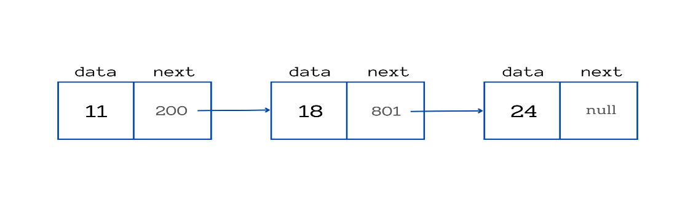
Queues
A queue is a linear data structure that follows the First In, First Out (FIFO) principle.
Elements are added at the back (or rear) and removed from the front of the queue.
The basic operations are similar to stack but except top(),we have front() and back()
Linked List
A linked list is a linear data structure consisting of nodes.
Each node contains two parts:
Data: Stores the value.
Pointer: Points to the next node in the sequence.
Types of Linked Lists
Singly Linked List: Each node points to the next node.
Doubly Linked List: Each node points to both the next and previous nodes.
Circular Linked List: The last node points back to the first node.

Slide 5
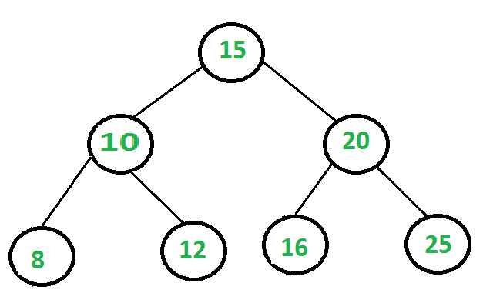
Trees
A tree data structure is a hierarchical structure that is used to represent and organize data in a way that is easy to navigate and search. It is a collection of nodes that are connected by edges and has a hierarchical relationship between the nodes.
The topmost node of the tree is called the root, and the nodes below it are called the child nodes. Each node can have multiple child nodes, and these child nodes can also have their own child nodes, forming a recursive structure.

Slide 6
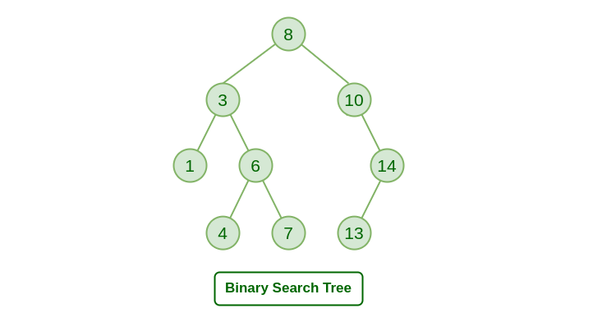
Binary Search Trees
It is a type of binary tree in which each node has at most two children, a left child and a right child, with the left child containing values less than the parent node and the right child containing values greater than the parent node. This hierarchical structure allows for efficient searching, insertion, and deletion operations on the data stored in the tree.

Slide 7
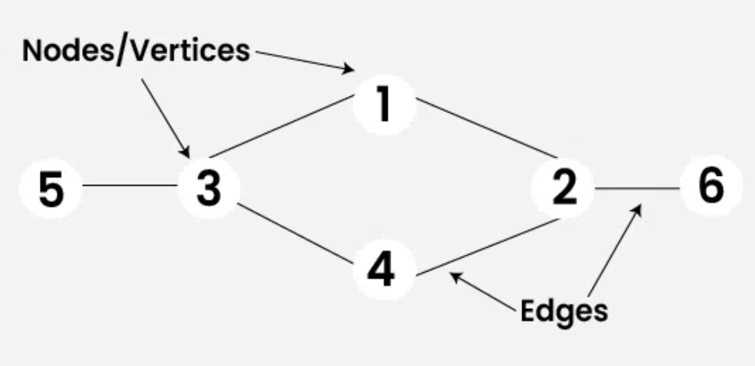
Graphs
A Graph is a non-linear data structure consisting of vertices and edges. The vertices are sometimes also referred to as nodes and the edges are lines or arcs that connect any two nodes in the graph. More formally a Graph is composed of a set of vertices( V ) and a set of edges( E ). The graph is denoted by G(V, E).
Two most common ways to represent a graph :
Adjacency Matrix
Adjacency List

Slide 8
Dikstra’s Algorithm
Dijkstra’s algorithm is used to find the shortest path between the two mentioned vertices of a graph by applying the Greedy as the basis of principle.
For Example: Used to find the shortest between the destination to visit from your current location on a Google map.
Algorithm for Dijkstra’s Algorithm:
Mark the source node with a current distance of 0 and the rest with infinity.
Set the non-visited node with the smallest current distance as the current node.
For each neighbor, N of the current node adds the current distance of the adjacent node with the weight of the edge connecting 0->1. If it is smaller than the current distance of Node, set it as the new current distance of N.
Mark the current node 1 as visited.
Go to step 2 if there are any nodes are unvisited.

Slide 9
Djikstra’s Algorithm in Plasma Reaction
The research paper discusses how graph theory can be applied to study plasma chemical reaction engineering, particularly focusing on atmospheric pressure plasmas.
By representing chemical reactions and species as nodes and edges, respectively, a "reaction network" can be created. This network helps visualize the relationships between different reactions and species, allowing researchers to identify important pathways and potential problems.
One of the key methodologies employed in the study is Dijkstra's algorithm.
The study utilizes open-source graph visualization software, Gephi, to visualize the reaction network. By representing reactions and species as nodes and edges with various attributes such as size, color, and label, researchers can gain valuable insights into the complex interactions within the plasma chemical system. The visualizations generated by Gephi help researchers identify patterns, potential bottlenecks, and promising pathways for further investigation.

Slide 10
The major limitations are:
The study assumes linear relationships between rate coefficients and electron energy or gas temperature, which may not always hold true in real-world scenarios.
The complexity of plasma chemical systems poses challenges in visualizing and interpreting large networks, especially when considering numerous reactions and species.
The research focuses on forward reactions without considering equilibrium reactions.
It overlooks the potential impact of reversible reactions and dynamic equilibria on the overall behavior of the system. Ignoring equilibrium reactions may lead to incomplete or inaccurate insights into reaction pathways and kinetics.

Slide 11
Monte Carlo Simulations
Monte Carlo simulations are a class of computational algorithms that use repeated random sampling to obtain numerical results.
They are used to model the probability of different outcomes in processes that are difficult to predict due to the intervention of random variables.
The major three steps involved in Monte Carlo Simulations are:
1.Identify a distribution that requires sampling
2.Draw some random samples from this distribution
3.Calculate mean of some particular function of interest
We have looked at three examples of Monty Hall Problem,Toy Collector Problem and Integral.

Slide 12
Simulating a Multicomponent Batch Distillation
Now,we will use the Monte Carlo Simulations to obtain the ternary diagram or residual curve.Initial number of molecules are 10000 and we will calculate it for 220 times and taking 38 as number of molecules of each type.
Steps:
Distillation Probability:
Probability of a molecule vaporizing depends on:
Number of molecules of the substance, Mi
Relative volatility,αi​
Expressed as: 𝑝𝑖=𝛼𝑖𝑀𝑖
Monte Carlo Simulation:
Calculate expectation values 𝑝𝑖=𝛼𝑖𝑀𝑖​.
Compute ratios 𝑟𝑖=𝑝𝑖/max(𝑝𝑖)
Compare 𝑟𝑖ri​ with random numbers between 0 and 1.
If 𝑟𝑖> random number, decrease 𝑀𝑖 by 1.
Else, 𝑀𝑖 remains the same.

Slide 13
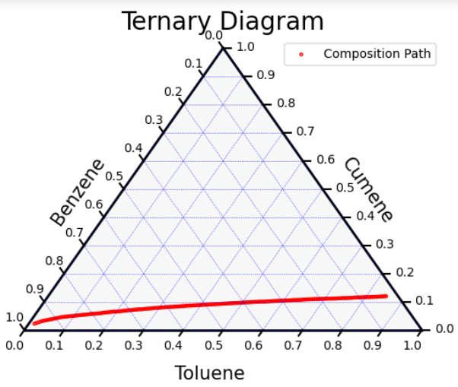
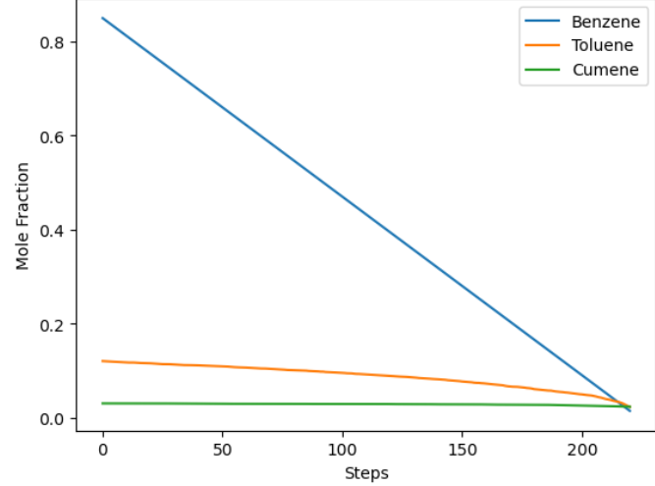
Results
The ternary diagram and diagram representing change in mole fraction at each step are given below:

Slide 14
Code
import pandas as pd
import numpy as np
import matplotlib.pyplot as plt
import ternary
import random
# Initial parameters
x_B = 0.85
x_T = 0.12
x_C = 0.03
alpha_B = 2.4
alpha_T = 1
alpha_C = 0.21
M_total = 10000
n = 38 # Number of iterations per step
m = 220 # Number of steps
# Initial number of molecules for each type
M_B = int(x_B * M_total)
M_T = int(x_T * M_total)
M_C = int(x_C * M_total)

Slide 15
# Store initial values
initial_values = [M_B, M_T, M_C]
molecule_counts = [initial_values]
# Function to perform one simulation step
def simulation_step(M,M_total):
ai = [alpha_B, alpha_T, alpha_C]
Pi = [ai[i] * M[i] for i in range(len(M))]
max_Pi = max(Pi)
ri = [Pi[i] / max_Pi for i in range(len(M))]
for i in range(len(M)):
if random.random() < ri[i]:
M[i] -= 1
M_total-=1
return M
x=[]
x.append((x_B,x_T,x_C))
# Run the simulation for m steps
for step in range(m):
for _ in range(n):
M_B, M_T, M_C = simulation_step([M_B, M_T, M_C],M_total)
x.append((M_B/M_total, M_T/M_total, M_C/M_total))

Slide 16
# Plotting the mole fractions over steps
mole_fractions_B = [z[0] for z in x]
mole_fractions_T = [z[1] for z in x]
mole_fractions_C = [z[2] for z in x]
steps = range(m+1)
plt.plot(steps, mole_fractions_B, label='Benzene')
plt.plot(steps, mole_fractions_T, label='Toluene')
plt.plot(steps, mole_fractions_C, label='Cumene')
plt.xlabel('Steps')
plt.ylabel('Mole Fraction')
plt.legend()
plt.show()

Slide 17
# Set up the ternary plot
scale = 1.0
figure, tax = ternary.figure(scale=scale)
# Draw boundary and grid lines
tax.boundary(linewidth=2.0)
tax.gridlines(multiple=0.1, color="blue")
# Set axis labels
fontsize = 15
tax.left_axis_label("Benzene", fontsize=fontsize,offset=0.12)
tax.right_axis_label("Cumene", fontsize=fontsize,offset=0.12)
tax.bottom_axis_label("Toluene", fontsize=fontsize,offset=0.12)
# Plot data points
tax.scatter(x, marker='o', facecolor='None',edgecolor='red',label='Composition Path',s=5)
# Add a title
tax.set_title("Ternary Diagram", fontsize=20)

Slide 18
# Set ticks
ticks = ticks = [str(i/10.0) for i in range(11)]
tax.ticks(axis='l', ticks=ticks,offset=0.02)
tax.ticks(axis='r', ticks=ticks,offset=0.02)
tax.ticks(axis='b', ticks=ticks,offset=0.02)
tax.clear_matplotlib_ticks()
tax.get_axes().axis('off')
# Show legend
tax.legend()
# Show the plot
tax.show()

